Slide 1
OBSTACLE AVOIDANCE ROBOT

Slide 2
Overview
Introduction
Block Diagram
Hardware Requirements
Software used
Applications
Future Work
References

Slide 3
Introduction
The obstacle avoidance robotics is used for detecting obstacles and avoiding the collision.
The design of obstacle avoidance robot requires the integration of many sensors according to their task.
Ultrasonic sensor is most suitable for obstacle detection and it is of low cost and has high ranging capability.

Slide 4
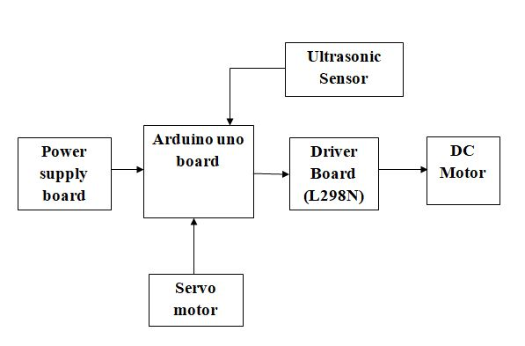
Block Diagram

Slide 5
Hardware requirements
Arduino Uno
Ultrasonic sensor (HC SR04)
DC Motor Driver L298N
DC Motor
Power Supply
Servo motor

Slide 6
Arduino UNO
Microcontroller board based on the ATmega328P.
14 digital input/output pins (of which 6 can be used as PWM outputs)
6 analog inputs.
16 MHz quartz crystal
A power jack
Connect it to a computer with a USB cable or power it with a AC-to-DC adapter or battery to get started.

Slide 7
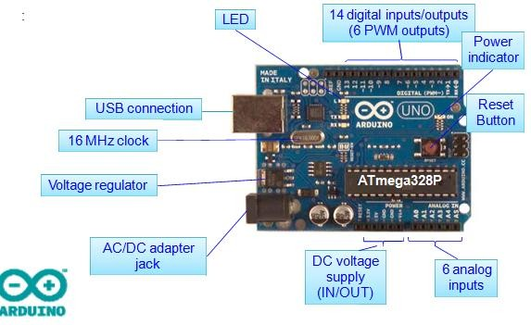
The board...

Slide 8
Ultrasonic Sensors (HC SR04)
The ultrasonic sensor is used for obstacle detection.
Ultrasonic sensor transmits the ultrasonic waves from its sensor head and again receives the ultrasonic waves reflected from an object.
The ultrasonic sensor enables the robot to virtually see and recognize object, avoid obstacles, measure distance.
The operating range of ultrasonic sensor is 10 cm to 30 cm.

Slide 9
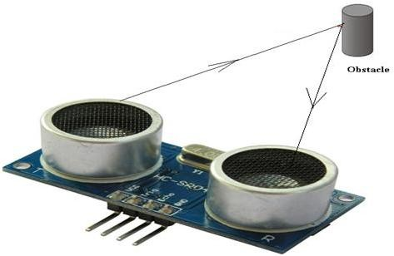
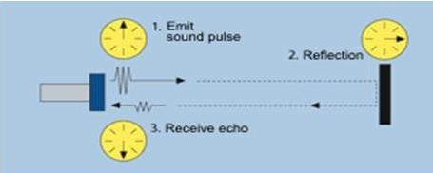
Working Principle

Slide 10
Features
Compact and light weight
High sensitivity and high pressure
High reliability
Power consumption of 20mA
Pulse in/out communication
Narrow acceptance angle
Provides exact, non-contact separation estimations within 2cm to 3m
3-pin header makes it simple to connect utilizing a servo development link

Slide 11
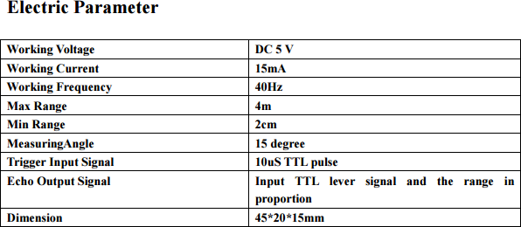

Slide 12
DC Motor Driver(L293D)
L293D has quadruple high current half-H drivers.
Wide Supply-Voltage Range: 4.5 V to 36 V
High-Noise-Immunity Inputs
Output Current 600mA Per Channel
Peak Output Current 1.2A Per Channel.

Slide 13
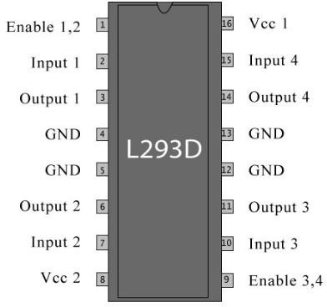
Pin Diagram

Slide 14
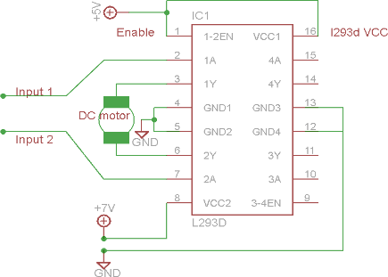
Circuit Diagram

Slide 15
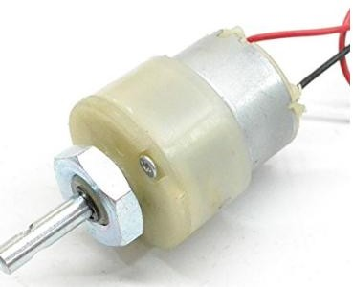
DC Motor
10 to 200RPM 12V DC motors with Gearbox
6mm shaft diameter with internal hole
No-Load Current=60mA(max)
Load Current=300mA(max)

Slide 16
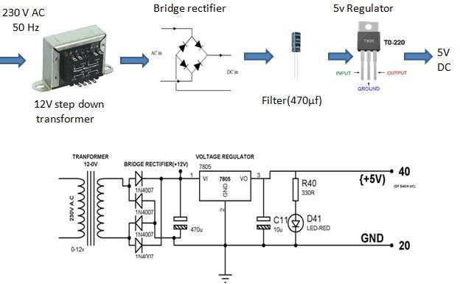
Power Supply

Slide 17
Software Used..
Arduino IDE
Programming Languages Used..
Embedded C/C++

Slide 18
Applications
Especially military applications
Vacuum Cleaner
Auto parking assistance

Slide 19
Future Work
Adding a Camera
Uses as a fire fighting robot

Slide 20
References
www.arduino.org
www.beyondlogic.org
www.wikipedia.org
www.elementzonline.com
www.elementztechblog.wordpress.com

Slide 21
Questions????

Slide 22
THANK YOU

